Slide 1
System sequence diagram
Dr. Taimoor Khan
Taimoor.khan@nu.edu.pk

Slide 2
What is a SSD
A way of modeling input and output events related to systems
It is a picture that shows, for one particular use case scenario, the events an external actor generates and in what order
Draw SSD for the main success scenario and complex alternatives
They show the system as a black box
There should be one for the main success scenario of a use case
Like Domain Models – very high level with a lower level counterpart

Slide 3
Process Sale Use Case
Simple cash-only Process Sale scenario:
1. Customer arrives at a POS checkout with goods and/or services to purchase.
2. Cashier starts a new sale.
3. Cashier enters item identifier.
4. System records sale line item and presents item description, price, and running total.
Cashier repeats steps 3-4 until indicates done.
5. System presents total with taxes calculated.
6. Cashier tells Customer the total, and asks for payment.
7. Customer pays and System handles payment.
...

Slide 5
Why Draw SSDs
Easy way to capture external events like “customer arrives at CheckOut”
A description of “what” the system does but with some time aspects

Slide 6
How to Name System Events
abstract intention
too physical
System event names should be expressed at the abstract level of intention

Slide 7
System sequence diagram
SSD is a picture that shows for one particular scenario of a use case, the events that external actors generate which trigger some inter-system events
This diagram treats the system as black box and only emphasize on events that cross the system boundary from actor to system
It illustrates inputs and outputs to the system

Slide 8
Motivation behind SSD
The motivation behind SSD is to design a pattern for handling external system requests and producing proper response
Events may be external (triggered by human or computer), time events or fault / exception events
It is useful to investigate and define system’s behavior as “black box” before proceeding with the detailed design
It shows events from one scenario of a use-case diagram and operations performed by system in response

Slide 9
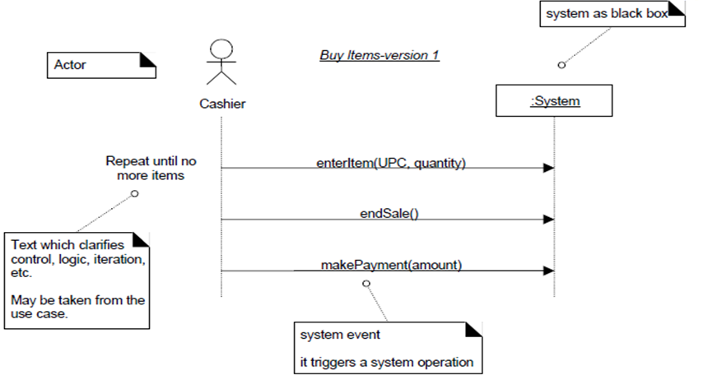
System sequence diagram

Slide 10
System events
System events: External input to system generated by actor
System operation: Methods invoked in response to system events
System events may have arguments
enterItem( UPC, quantity )
raise( money )

Slide 11
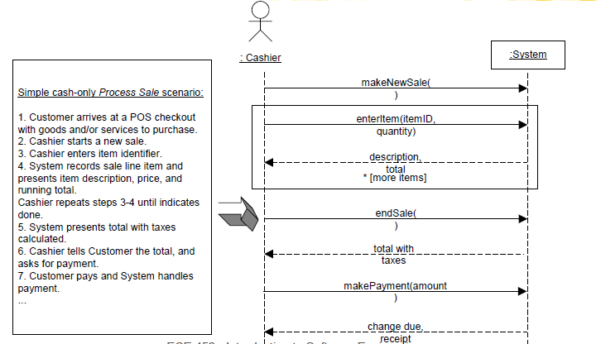
System sequence diagram

Slide 12
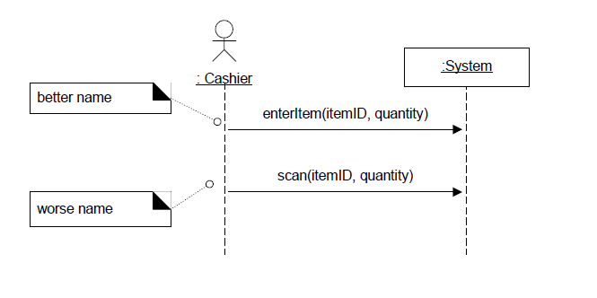
Naming system events and operations

Slide 13
Difference with sequence diagram
Sequence diagram shows the internal operations of the system triggered by events.
It ignores the external events source
Operations are drawn between different objects of the system
The flow of messaging is maintained

Slide 14
A Sequence Diagram
member: LibraryMember
book:Book
copy:Copy
borrow(book)
ok = mayBorrow()
[ok] borrow(member)
setTaken(member)

